Slide 1
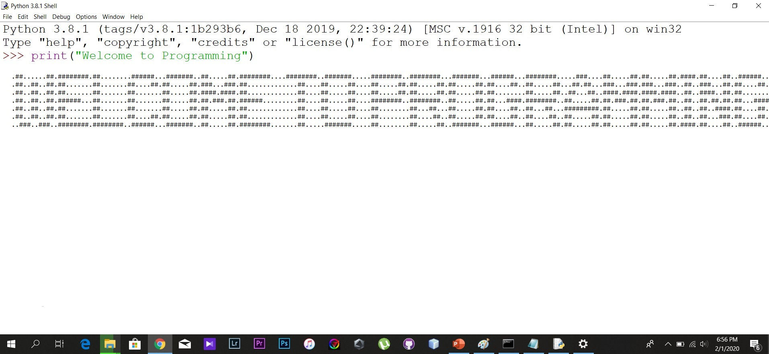
Start
Print “Welcome to Programming”
End
-Bro Army-

Slide 2
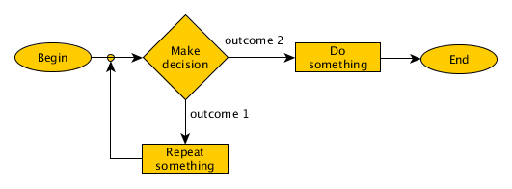
What is a problem?
A problem is a puzzle that requires logical thought or mathematics to solve it.
-Taken from Collins Dictionary(https://www.collinsdictionary.com/dictionary/english/problem )
In this presentation we only talk about the problems that are solved by using algorithms.
Figure 1.1

Slide 3

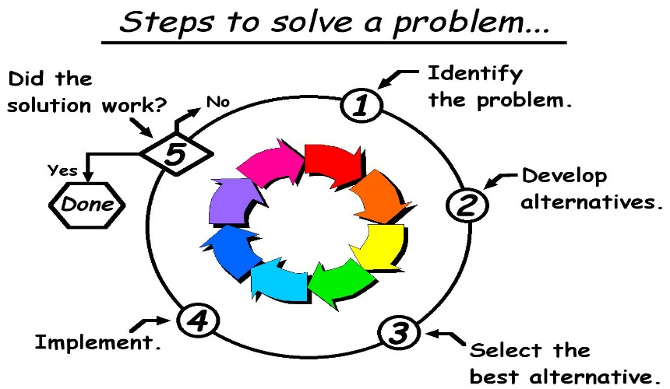
HOW TO SOLVE A PROBLEM
Identify the problem.
Make some hypothesizes
Test those hypothesizes and note down the results of them
Analyze the results
Arriving to a conclusion.

Slide 4
Algorithms

Slide 5
Algorithms
What is an Algorithm?
Definition about an Algorithm
Control Structures in an Algorithm
Ways of Representing An Algorithm?
Flowchart
Sequence
Selection
Iteration
Pseudocodes

Slide 6
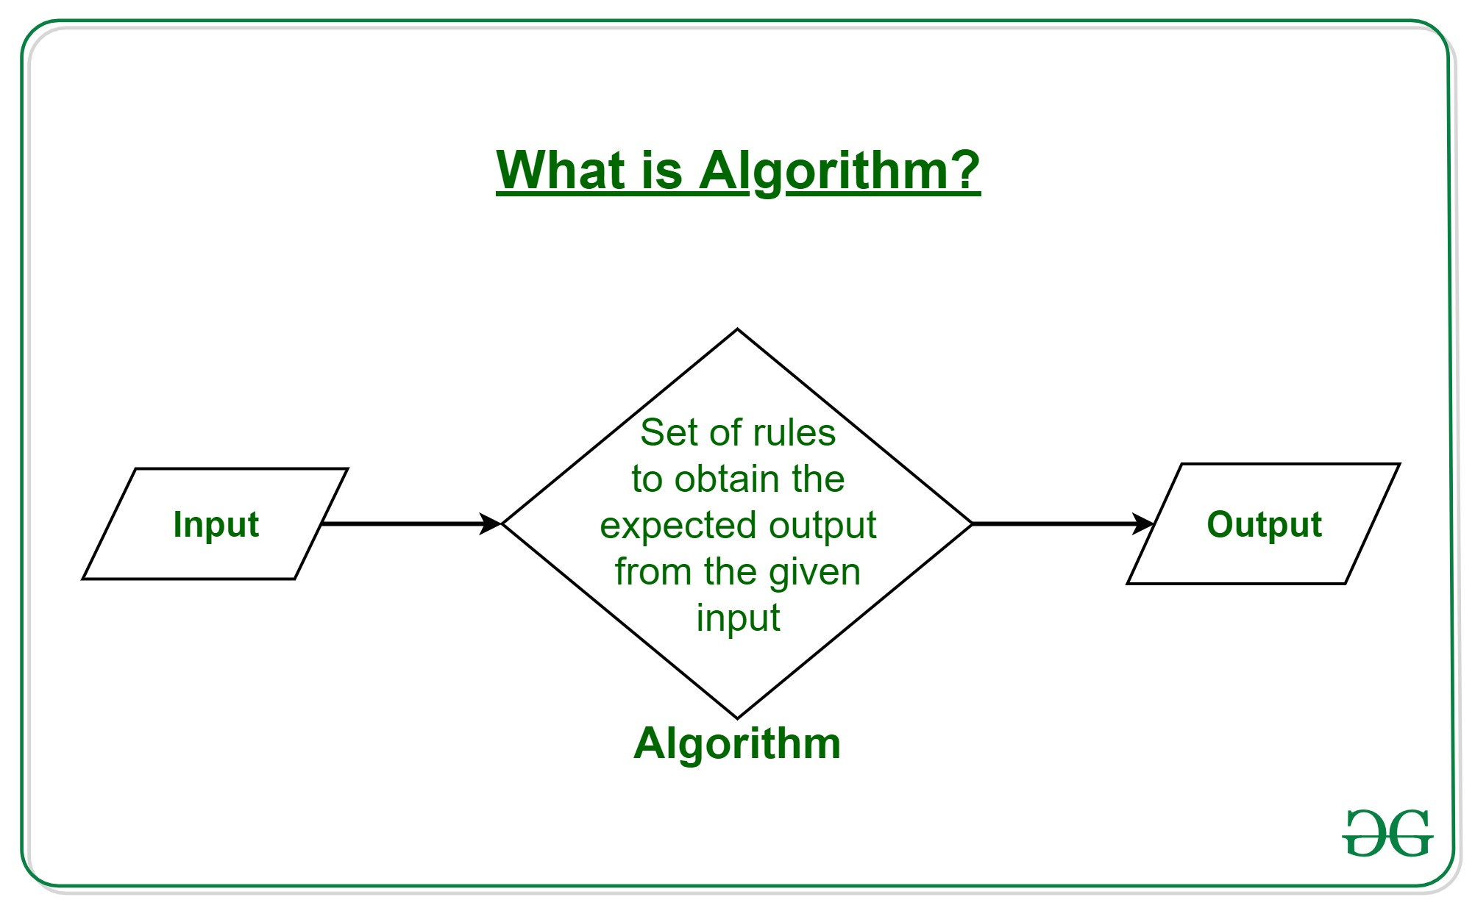
What is an Algorithm?
An Algorithm is a method to show the steps in solving a problem.
An Algorithm is a step-by-step procedure for solving a problem

Slide 7
Control Structures in an Algorithm
Sequence
A step by step instruction given to solve a problem.
Selection
There is a selection to the given solution for the problem.
Iteration
The code will repeat multiple times in order to find a solution to the problem.
The problem is solved from the first step to the last step in order.
The Algorithm will continue based on the selection of the user.
The output of the program will also depend on the selection of the user.
The solution will iterate until the user is satisfied and then the code will be terminated.

Slide 8
Ways of representing an Algorithm
Flowcharts.
Pseudocodes.

Slide 9
Flowcharts

Slide 10
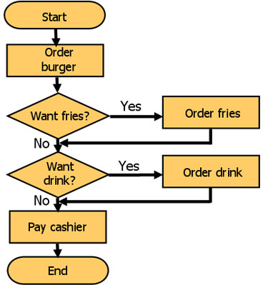
WHAT IS A FLOWCHART?
A flowchart is a formalized graphic representation of a logic sequence. The purpose of a flowchart is to provide people with a common language or reference point when dealing with a project or process. You can also use them to define and analyze a process, build a step-by-step picture of it, and then standardize or improve it. Each step is represented by a symbol and connecting lines show the step-by-step progression through the task.
Figure 1

Slide 11
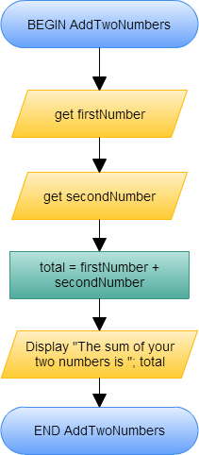
Sequence ?
In a computer program or an algorithm, sequence involves simple steps which are to be executed one after the other. The steps are executed in the same order in which they are written.
Have a look at the example on the right. Set of instructions to add two numbers and display the answer.
Figure 2

Slide 12
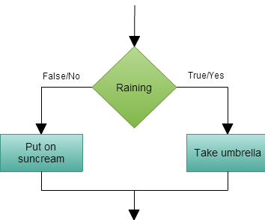
Selection ?
Selection is used in a computer program or an algorithm to determine which particular step or set of steps is to be executed. You can give conditions that can be used when choosing specific paths depending on possibilities.
Here is an example of a selection on what you would do during a rainy day and a one that’s not.
Figure 3

Slide 13
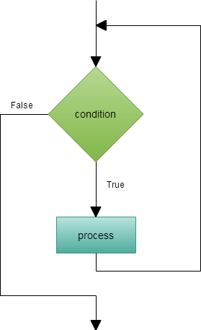
Repetition ?
Repetition allows for a portion of an algorithm or computer program to be executed any number of times dependent on some condition being met. An occurrence of repetition is usually known as a loop. Each of these loops have a termination condition that stops the repetition.
Here is an example for a repetition or a loop.
Figure 4

Slide 14
Pseudocodes

Slide 15
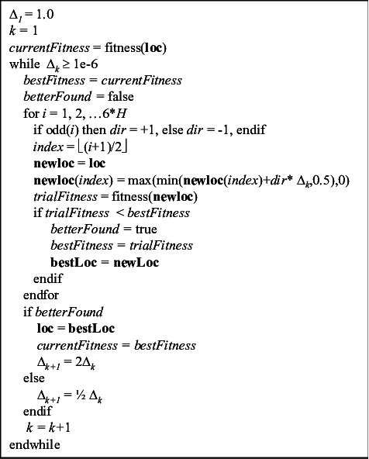
Pseudocodes
Pseudocode is an informal high-level description of the operating principle of a computer program or other algorithm. It uses the structural conventions of a normal programming language, but is intended for human reading rather than machine reading.
-Wikipedia-

Slide 16
pseudocodeS
Sequence
When designing algorithms, it is important to make sure that all the steps are presented in the correct order. This is known as sequencing.
eg :
ask how old the dog is in human years
multiply human years by seven to find out how old the dog is in dog years
print the answer on the screen
OUTPUT 'How old is your dog?‘
INPUT user inputs their dog's age in human years
STORE the user's input in the human_years variable dog_years = human_years * 7
OUTPUT 'In dog years, your dog is aged' + dog_years
pseudocode
https://www.bbc.co.uk/bitesize/guides/zsf8d2p/revision/1,https://www.bbc.co.uk/bitesize/guides/zsf8d2p/revision/3

Slide 17
Selection
When designing algorithms, there are many steps where decisions must be made. This decision is known as selection.
eg :
ask how old the dog is in human years
multiply human years by seven to find out how old the dog is in dog years
print the answer on the screen
ask how old you are
if the dog’s age in dog years is older than your age, say ‘Your dog is older than you!’
otherwise, say ‘Your dog is not older than you.’
OUTPUT 'How old is your dog?'
INPUT user inputs their dog's age in human years
STORE the user's input in the human_years variable
dog_years = human_years * 7
OUTPUT 'In dog years, your dog is aged ' + dog_years
OUTPUT 'How old are you?'
INPUT user inputs their age
STORE the user's input in the user_age variable
IF dog_years > user_age THEN
OUTPUT 'Your dog is older than you!'
ELSE
OUTPUT 'Your dog is not older than you.'
pseudocode
https://www.bbc.co.uk/bitesize/guides/zy3q7ty/revision/2
https://www.bbc.co.uk/bitesize/guides/zy3q7ty/revision/3

Slide 18
Iteration
When designing algorithms, there may be some steps that need repeating. This is known as iteration.
eg :
set number_of_teeth_cleaned to 0
put toothpaste on toothbrush
use toothbrush to clean a tooth
increase number_of_teeth_cleaned by 1
if number_of_teeth_cleaned < 32 then go back to step 3
rinse toothbrush
number_of_teeth_cleaned = 0
put toothpaste on toothbrush
REPEAT
procedure clean_tooth
number_of_teeth_cleaned = number_of_teeth_cleaned + 1 UNTIL number_of_teeth_cleaned = 32
rinse toothbrush
pseudocode
https://www.bbc.co.uk/bitesize/guides/zg46tfr/revision/2
https://www.bbc.co.uk/bitesize/guides/zg46tfr/revision/4

Slide 19
Examples & Summary

Slide 20
Sequence
Start
Example 1 : Adding 3 Numbers
Input num1,
num2,num3
CALCULATE_TOTAL
1.GET num1,num2,num3
2.CALCULATE Total=num1+num2+num3
3.PRINT Total
Total=num1+num2+num3
Print Total
End

Slide 21
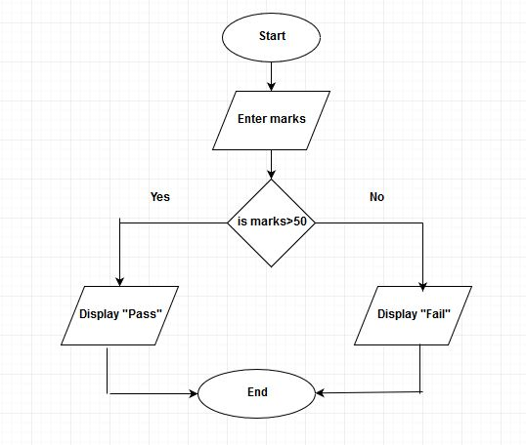
Selection
Example 2 :Determine if Pass or Fail
DETERMINE_THE_GRADE
1.GET Marks
2.IF Marks >= 50 then:
DISPLAY “Pass”
ELSE:
Display “Fail”

Slide 22
Iteration
Example 3 :Calculate Class Average
CALCULATE_AVERAGE_MARKS
1.GET StudentCount
2.WHILE StudentCount>=1:
INPUT Marks
CALCULATE Total=Total+Marks
StudentCount= StudentCount-1
3.CALCULATE Average=Total/ StudentCount
4.PRINT Average

Slide 23
Thank You
Done by:
Vihanga Fernanado.
Thevindu Rajapakse.
Pasindu Peiris.
Hamza Hassan.
Lashan Mendis.

